Slide 1
Bell Work (Prepare for Quiz – Next Class!): 1.) Find the slope, and the x and y-intercepts: 2y + 8 = 4x 2.) Write the equation of the line through (2, -5) and (-1, 3)

Slide 2
ALGEBRA 3
Day 19

Slide 3
From Last Time…
New Material (Section 2.5)
Page 96 #1, 7, 9, 13, 15-17, 27
New Material (Section 2.6)
Page 103 #5, 6, 13, 19-21, 55

Slide 4
Chapter 2 Section 7 Absolute Value Functions and Graphs
Objective: To graph absolute value functions

Slide 5
Chapter 2 Section 6 Review Remember…
Parent Graph – graph simplest form in a set of functions that form a “family”
Transformation—each function in the “family” that is related to the parent (like the kid to the parent)

Slide 6
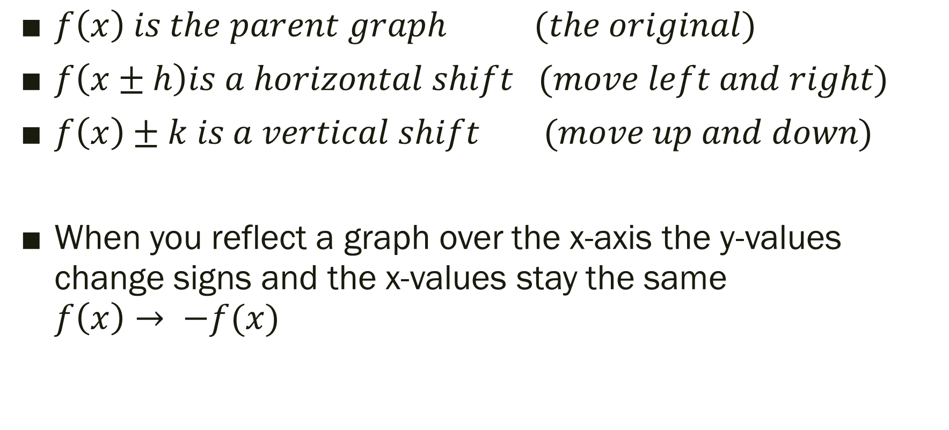
Types of Transformations
$f\left(x\right) is the parent graph (the original)$
$f\left(x±h\right)is a horizontal shift (move left and right)$
$f\left(x\right)±k is a vertical shift (move up and down)$
When you reflect a graph over the x-axis the y-values change signs and the x-values stay the same $f\left(x\right)→ −f(x)$

Slide 7

2.7 Transformation of Absolute Value
Parent Graph:
$$f\left(x\right)=\left|x\right|$$
Transformation of Parent:
$$f\left(x\right)=a\left|x−h\right|+k$$

Slide 8
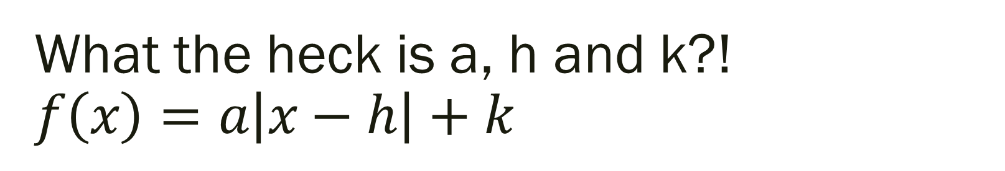
What the heck is a, h and k?! $$f\left(x\right)=a\left|x−h\right|+k$$
The graph is V-shaped
Vertex: (h, k) (think opposite value for h… like before)
Line of Symmetry: x = h (Symmetric about line of symmetry)
a = SLOPE of graph RIGHT of the line of symmetry
Opens up if a > 0 and down if a < 0
h shifts left and right, k shifts up and down

Slide 9

Example (Using Graphing Calculator): Describe the transformation.
Parent Graph $f\left(x\right)=|x|$
1.) $f\left(x\right)=|x+2|$
2.) g$\left(x\right)=\left|x\right|−3$
3.) h$\left(x\right)=\left|x−4\right|+1$
4.) $f\left(x\right)=\frac{1}{3}\left|x+5\right|−4$
5.) $f\left(x\right)=−4\left|x−3\right|+5$

Slide 10
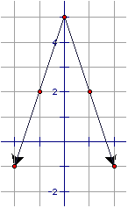
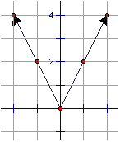
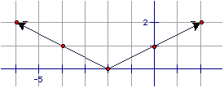
Write the equation of the graphs below…

Slide 11
For Next Time…
New Material
Page 110 #9, 11, 15, 25, 29, 34
Mixed Review
Page 113 #61, 63, 64

